Slide 1

PYTHON PROJECT

Slide 2
Python Tutor using Voice Assistant

Slide 3
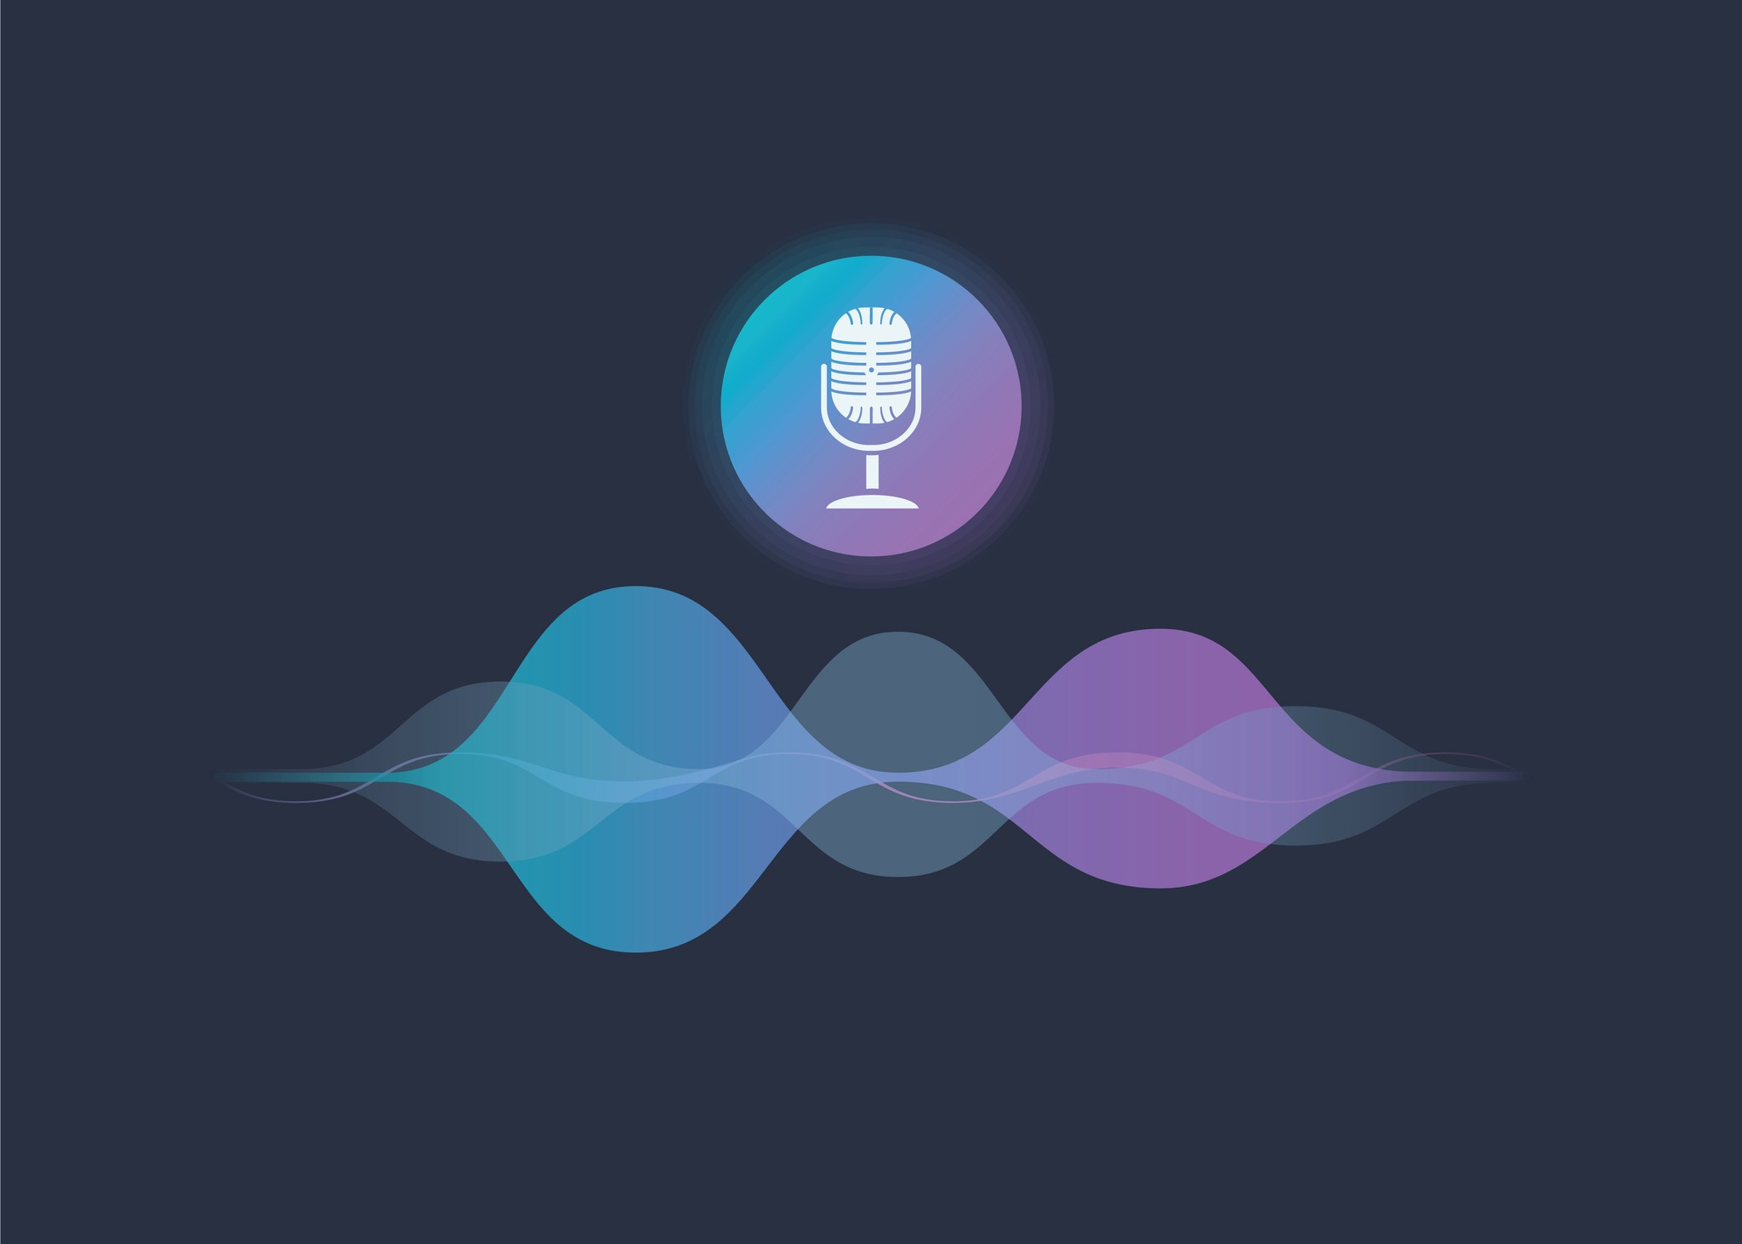

Slide 4
This assistant can talk to you or communicate with you using your voice like Google Assistant .
But, this will not be that much advanced, this will totally depend on the if..else.. condition which we will use inside our Program.

Slide 5
AIM
main Aim is making python learning more interactive using voice assistant.
In the project we add lot of python topics like loop, function etc. in the if else statement and in this way we tried to make our program a python learning program .
This project will help the student to learn python language more easily because our project communicate with the user so that student will learn things very fast.
This program is very easy to use and it interact to the user very fast

Slide 7
REQUIREMENTS
There are three requirements–
PyAudio
Speech Recognition
Pyttsx3

Slide 8
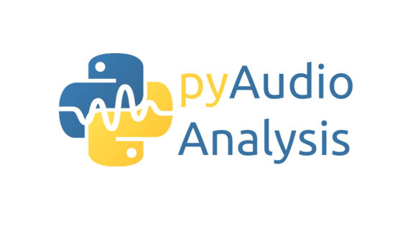
PyAudio
PyAudio provides Python bindings for PortAudio, the cross-platform audio I/O library. With PyAudio, you can easily use Python to play and record audio on a variety of platforms. PyAudio is inspired by:
1.pyPortAudio/fastaudio: Python bindings for PortAudio v18 API.
2.tkSnack: cross-platform sound toolkit for Tcl/Tk and Python.
To install pyaudio, go to command prompt and type
pip install pyaudio

Slide 9
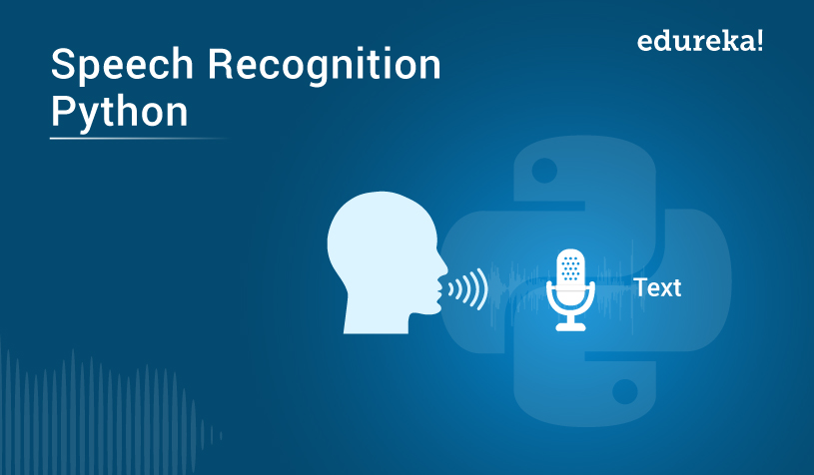
Speech Recognition
Speech recognition is the process of converting audio into text. This is commonly used in voice assistants like Alexa, Siri, etc. Python provides an API called SpeechRecognition to allow us to convert audio into text for further processing. In this article, we will look at converting large or long audio files into text using the SpeechRecognition API in python
To install SpeechRecognition, go to command prompt and type
Pip install speechrecognition

Slide 10
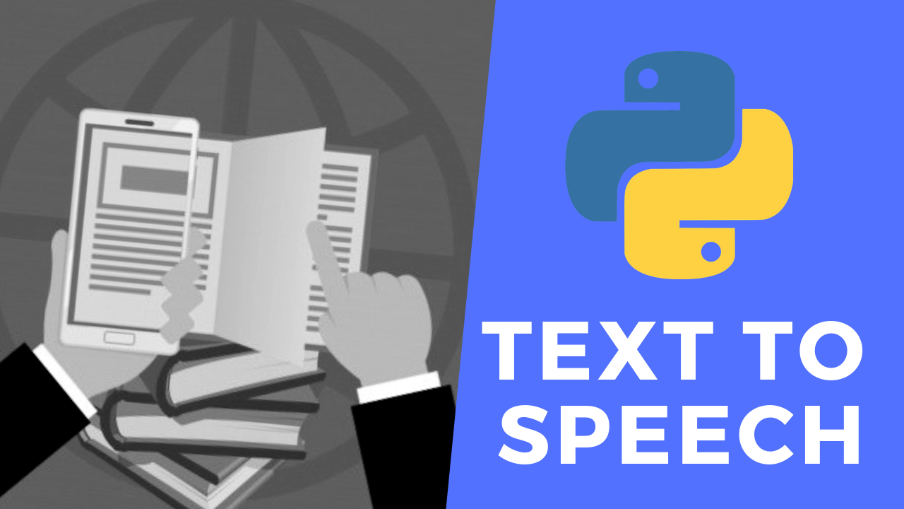
Pyttsx3
This module is used for conversion of text to speech in a program it works offline
To install Pyttsx3, go to command prompt and type
Pip install pyttsx3

Slide 11
Explanation:
We have used three modules of Python here, pyaudio is working in the background and is necessary to be installed.
Here, we have made the take_command() function so that it can be used here as the ear of our voice assistant in Python which ultimately uses the speech_recognition module.
Similarly, we have made the Speak() function so that it can be used here as the mouth of our voice assistant in Python which ultimately uses the pyttsx3 module.

Slide 12


